Slide 1
New Problems, New Thinking
(insert date)

Slide 2
Objectives
By the end of this lesson, you will be able to:
  Identify changes in problem complexity and scope at the flight level.
  Consider ways to address complex problems as a flight-level leader.
  Explain effective behaviors for problem solving and decision making in command.

Slide 3
Small Group Discussion
In your small groups, consider the types of problems you may face as a flight commander.
What will change now that you are
a flight-level leader?
Five (5) minutes – then be prepared to brief your results

Slide 4
Large Group Discussion
What did you learn?
What will change now that you are a flight-level leader?

Slide 5
The VUCA Environment
Volatile
Uncertain
Complex
Ambiguous

Slide 6
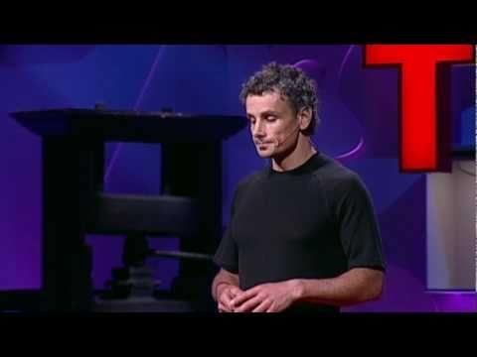
Simplifying Complexity

Slide 7

Wicked Problems

Slide 8
Raising Awareness
How can we increase success
in the VUCA environment?
Think differently about →
Critical Thinking
Creative Thinking
Problem Solving
Decision Making

Slide 9
Small Group Discussion
In your small groups, consider one of the behaviors on the handout:
  Groups choose one of the four behaviors (Critical Thinking, Creative Thinking, Problem Solving, Decision Making) to discuss
What do these behaviors mean to you?
What other tips, from your own experience, will drive improvement?
Ten (10) minutes – then be prepared to brief your results

Slide 10
Large Group Discussion
What did you learn?
Critical Thinking, Creative Thinking,
Problem Solving, Decision Making
What other ways can we improve?
(Record personal tips on your worksheet)

Slide 11
Self-Assessment Exercise
Honestly assess yourself against the listed criteria
  Results are private – sharing is not the intended goal
Contemplate steps for future improvement
You will need these worksheets to finish your Personal Development Plan (PDP) and complete this course.

Slide 12
Break
Come back in 10 minutes!

